Slide 1

Shaklee Micro Services – Challenges & Gaps
Fault Tolerance
Load balancing
Auto Scaling
How to avoid cascading failures due to system failures or service latencies ?
How do we isolate failures and remain resilient to failures?
Fault tolerance approaches
How are we facilitating graceful degradation, fail fast and rapid recovery?
What is our service load balancing strategy in middle-tier? Can we adopt client-side software load balancer?
Central load balancer (HAProxy) induces extra hop, cannot talk to service registry.
How are we auto scaling services? (Spin out new service instances)
Product
Mgmt.
Services
Request Tracking
Log Aggregation
How to track a request across call chain? Aggregating logs distributed across services?
API Gateway
Invoke services
Genealogy
Services
Service Orchestrator
Service Load balancer
Load balancer
Inter Service Comm.
Security
Order
Mgmt.
Services
How to avoid spaghetti & fan-out calls between services?
How authentication, authorization, confidentiality, integrity are achieved?
How security context is propagated from API Gateway to individual services?
Will services authenticate every request?
Service discovery
Register services
Service Registry
Promotion
Mgmt.
Services
Monitoring & Stats
Curator
Zookeeper
Health Checks
Identify & finalize toolset to monitoring services & stats and then visualize.
Device specific endpoints
What is our strategy tailoring data based on device? (May not be a immediate concern).
Will the registry responsible for service health checks? Will it remove faulty service instance from the registry automatically?

Slide 2
Fault Tolerant Architecture
Fault-Tolerance
Fault-Tolerance Approaches
High volume, high availability systems must be tolerant to latencies, service & network failures without system outage. Service instances can fail at any moment, system design must handle such failures gracefully.
Network timeouts & retries
Separate threads per request using per-service thread pools (Bulk-head pattern)
Fallbacks & Circuit breakers.
Concurrent Requests
API Gateway or Orchestrator
Network Failure
Per-service Thread pool
Per-service Thread pool
Service Failure
Bulkhead
Downstream
Connections
Fixed Timeouts
Faults can be,
Network glitches
Service failures
Service latencies
Service
#1
Service
#2
Notes:
Call with timeouts
Retries
Retry if result is ?
Retry if exception is
Retry if runtime exception
Retry attempts
bulkhead pattern to isolate dependencies and limit concurrent access. Separate thread pools are used per dependency so that concurrent requests are constrained. Latency on the underlying executions will saturate the available threads only in that pool. Using semaphores instead of thread-pools is also an option, which allows for load shedding, but not time-outs.
*** Clients (libraries, network calls, etc) execute on separate threads. This isolates them from the calling thread (Tomcat thread pool) so that the caller may “walk away” from a dependency call that is taking too long.
Hystrix uses separate, per-dependency thread pools as a way of constraining any given dependency so latency on the underlying executions will saturate the available threads only in that pool.
https://github.com/Netflix/Hystrix/wiki/How-it-Works#Isolation

Slide 3

How to build fault tolerance in API Gateway?
‘Service Orchestrator’ should implement fault-tolerant approaches detailed in previous slide. This can be achieved through Apache Camel’s in-built components / features to certain extent.
Timeouts & Retries
// Incase of io exception then try to redeliver up till 2 times.
onException(IOException.class).maximumRedeliveries(2).redeliveryDelay(0)
// timeouts, on service innovations …
TODO
Per-service thread pools
// Thread pools
TODO – Requires PoC
http://camel.apache.org/threading-model.html
PoC
? days
Camel does not implement circuit breaker pattern
Shall we adopt Netflix’s Hystrix latency and fault tolerance library designed to isolate points of access to remote systems, services and 3rd party libraries?

Slide 4

Service Load balancing
There are two approaches for load balancing in middle-tier,
Central Load balancer (H/W or S/W)
Client based S/W Load balancer
Central load balancers such as HAProxy requires a additional hop (proxy layer), which induces administrative overheads, latency and another layer of potential faults/failure.
Cannot integrate with service registry to get list of service instances on the fly.
Can route traffic based on health checks, but may not use real time synthetic transaction statistics to load balance traffic. Might use just heart beating technique *.
Client can decide which service instance it cant connect to based on contextual information (which can change from client to client)
Balancer is capable of integrating with service registry & discovery in a dynamic environment where services are added or removed dynamically from the registry.
Has knowledge of how services are performing (response times, latencies) and decide traffic routing.
Can we adopt Netflix’s Ribbon load balancer library?
In case, we adopt client-based software load balancer such as Ribbon, load balancing client should be part of API Gateway subsystem.
PoC
? days

Slide 5


Auto scaling services
The main intent to adopt ‘Micro Services’ architecture is to have ability scale up and down the services on demand. As we finalized hosting platform as AWS, Can we adopt ‘Auto Scaling Groups’ for auto provisioning of instances?
Auto scalability policy?
Scaling based on resource thresholds
Leverage Amazon CloudWatch to monitor resource utilization, application performance, and operational health.
Set alarms on any of metrics to take automated actions. For example, when a specific AWS instance metric crosses alarm threshold, use Auto Scaling to dynamically add or remove instances.
4 Micro-services instances
CPU > 60%
per 1 min
Memory Usage > 70%
per 1 min
Auto Scale Up
Auto Scale Down
2 Micro-services instances
2 Micro-services instances
Requests per second (TPS) > 100

Slide 6


Tracking & Log Aggregation
S1
Correlation Request ID: J2U92MX2891IPD493
Induce correlation ids in every request for distributed tracing of requests, as a single request will fan-out to multiple downstream service requests where tracing will be difficult.
Distributed tracing can be performed using the correlation ids by combining all the downstream service logs and matching the required id to see the trace of the request throughout entire application stack. This enforces to use centralized logging framework.
(which is very easy if you are using a centralized logging framework such as logstash)
Correlation Request ID: J2U92MX2891IPD493
S1a
S1b
Correlation Request ID: J2U92MX2891IPD493
Correlation Request ID: J2U92MX2891IPD493
Which centralized logging framework are we planning to adopt?
Can we adopt following open-source toolset? Or Shall we go with Splunk or other alternatives.
Logstash is an open source tool for collecting, parsing, and storing logs for future use.
PoC
? days
Kibana is a web interface that can be used to search and view the logs that Logstash has indexed.

Slide 7

Service to service communication
Are we allowing spaghetti communication between services?
Direct communication between service to service will result in spaghetti communications show in red color in the diagram.
Service
#1
dependency
API Gateway
Invoke services
Service
#2
Service Orchestrator
dependency
dependency
Service
#3
Option 1: Service-to-service communications through API Gateway introduces additional hops (shown in green color).
Service
#4
dependency
Option 2: Shall we approach asynchronous event driven model? Need further investigation.

Slide 8
Caching
Caching improves the scalability and performance of the platform. Caching must implemented across all tiers/layers of the system,
@ Browser
@ API Gateway
@ Micro-Service
Rely on Cloudflare optimization of web content. Cloudflare can change the http headers so that browser can cache static content.
Use ETags for caching and conditional requests for API calls. It will reduce load on the system.
User Angular.js cacheFactory for data caching, https://docs.angularjs.org/api/ng/service/$cacheFactory
Cache service discovery information (by load balancer)
Cache frequently used reference data or master data such as product categories & product types and more.
Explore usage of Memcache, EHCache, Redis & libraries such as spymemcached (https://code.google.com/p/spymemcached/)
What is our cache refresh strategy? Are we going with write through caching?
Use secondary cache between Play & Database or external resources.

Slide 9

Security
Auth. & Author.
Confidentiality
Integrity
Non-repudiation
Security propagation
Need a central identity store to register & manage Shaklee members and their profile. Is there a store that already provides these functions? Can we leverage it?
The store should also manage roles, permissions/tokens.
Should provide user interface to manage Shaklee members & their hierarchy, and functions such as forgot password, notifications. Including REST based API.
Must implement OAuth 2.0 protocol.
Shall we explore open-source providers or COTS tools rather implementing our own?
Should provide migration tools to migrate existing member profiles.
Authorization
Server /
Service
No propagation of access token to down stream services to avoid fan-out token validation calls.
API Gateway retrieves member profile propagates to services.
Trusted communication between API Gateway & Micro services (eg, client certificates, key based, …)
Introduces certificate management & revocation overheads.
Token Validation
Product
Mgmt.
Services
Member Profile & Token
Auth.
Token Validation
Genealogy
Services
API Gateway
Login: Username & password
Device &
User
JWT access token
Order
Mgmt.
Services
PoC
? days
API Calls: JWT in every secure resource request
Identify & evaluate identity store
Identify & evaluate OAuth 2.0 providers
Server to Server communications

Slide 10
Monitoring Services
Monitoring regime is essential to detect problems quickly in a distributed environment. Performance monitoring of each individual micro-services is necessary. Shall we adopt following tools,
Commercial
http://newrelic.com/
https://www.ruxit.com/
Appdynamics - http://www.appdynamics.com/
Open-source tools
Statsd -https://github.com/etsy/statsd
Graphite - http://graphite.readthedocs.org/en/latest/
Apart from infrastructure & resource monitoring tools such as,
Ganglina - http://ganglia.sourceforge.net/
Nagios - http://www.nagios.org/

Slide 11
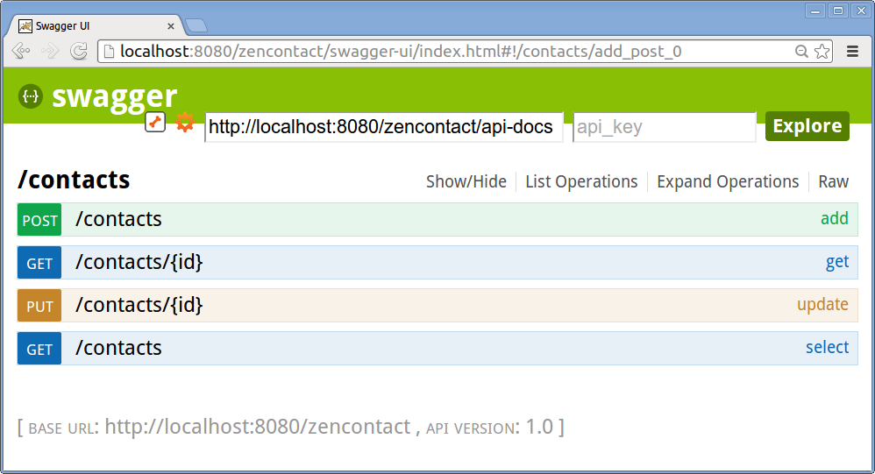
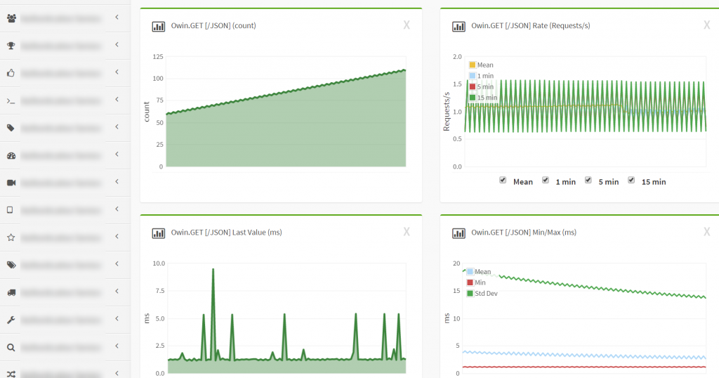
API Documentation
For API documentation, can we use http://swagger.io?

Slide 12
References & Credits
http://netflix.github.io/ - Netflix Open Source Software Center
http://martinfowler.com/articles/microservices.html
http://www.infoq.com/microservices

Slide 13
Canonical Data Model & Data Transformation
TODO

